Slide 1
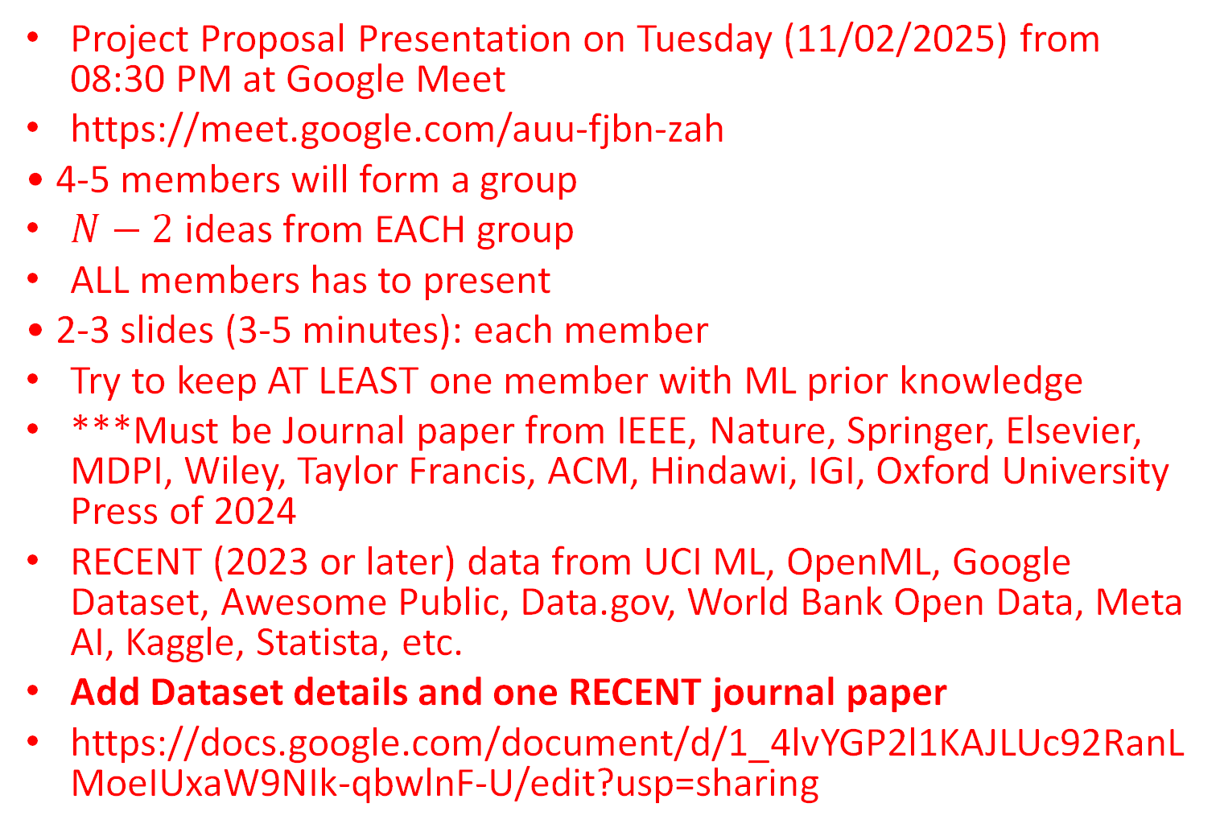
Guidelines
Project Proposal Presentation on Tuesday (11/02/2025) from 08:30 PM at Google Meet
https://meet.google.com/auu-fjbn-zah
• 4-5 members will form a group
$N−2$ ideas from EACH group
ALL members has to present
• 2-3 slides (3-5 minutes): each member
Try to keep AT LEAST one member with ML prior knowledge
***Must be Journal paper from IEEE, Nature, Springer, Elsevier, MDPI, Wiley, Taylor Francis, ACM, Hindawi, IGI, Oxford University Press of 2024
RECENT (2023 or later) data from UCI ML, OpenML, Google Dataset, Awesome Public, Data.gov, World Bank Open Data, Meta AI, Kaggle, Statista, etc.
Add Dataset details and one RECENT journal paper
https://docs.google.com/document/d/1_4lvYGP2l1KAJLUc92RanLMoeIUxaW9NIk-qbwlnF-U/edit?usp=sharing

Slide 2
CSE445 Project Proposal Presentation Group: 1
Student Name:
Student ID:
/02/2025

Slide 3
Diabetes prediction using Machine Learning
CSE445
Project Proposal

Slide 4
Diabetes prediction using Machine Learning
Regression or classification problem? Classification
What the system will predict? Diabetes
How many classes/categories: 2 in this case (binary classifier)
Name of the classes? Diabetes: Yes (1) or No (0)
How many samples? 768
How many features? 8
Name of the features? # of pregnancies, Glucose, Blood Pressure, BMI, Skin thickness, insulin level, age, Diabetes pedigree function

Slide 5
Required Dataset
Pima Indians Diabetes Database: 07/10/2024
https://archive.ics.uci.edu/dataset/1031/dataset+for+assessing+mathematics+learning+in+higher+education
2. LMCH Iraqi Dataset: 18/07/2020
https://data.mendeley.com/datasets/wj9rwkp9c2/1
***Please provide the dataset source***
3. What are the features in the dataset? Eight Features
Pregnancies | Skin Thickness | Diabetes pedigree function
Glucose | Insulin | Age
Blood Pressure | BMI

Slide 6
Recent Journal Papers
Link: https://www.nature.com/articles/s41598-024-78519-8
Title: Robust diabetic prediction using ensemble machine learning models with synthetic minority over-sampling technique
Year: 2024
Novelty: Robust framework for diabetes prediction using Synthetic Minority Over-sampling Technique (SMOTE) with ensemble machine learning techniques
***Must be Journal paper from IEEE, Nature, Springer, Elsevier, MDPI, Wiley, Taylor Francis, ACM, Hindawi, IGI, Oxford University Press of 2024

